Slide 1



Mapping Tools
Field Papers, GPS Units and OSM Tracker

Slide 2
WHAT IS A FIELD PAPER ?

Slide 3
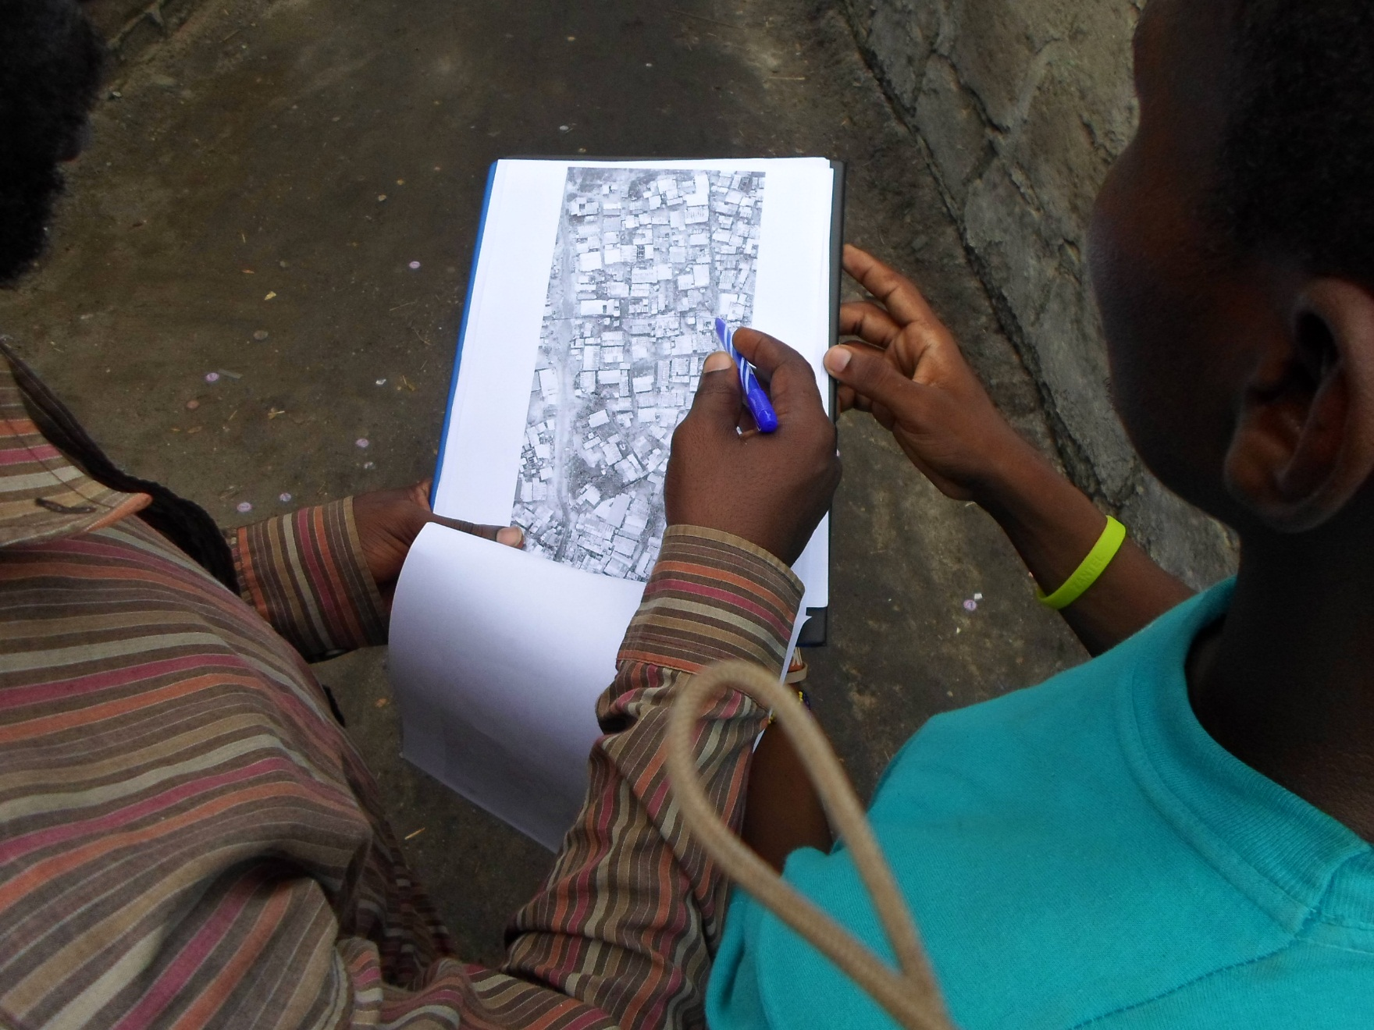
FieldPapers is web-based tool for easily creating a printable map atlas for anywhere in the world that you can print and add notes to.

Slide 4
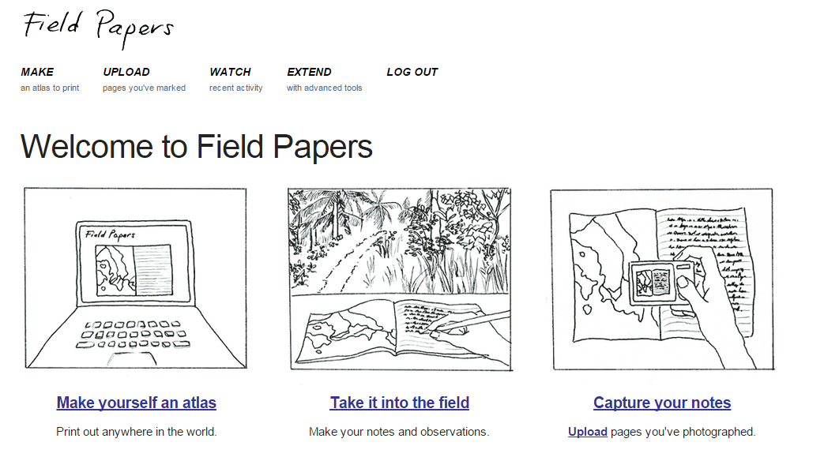
STEPS FOR CREATING ONE (www.fieldpapers.org)
Create an account (optional)

Slide 5
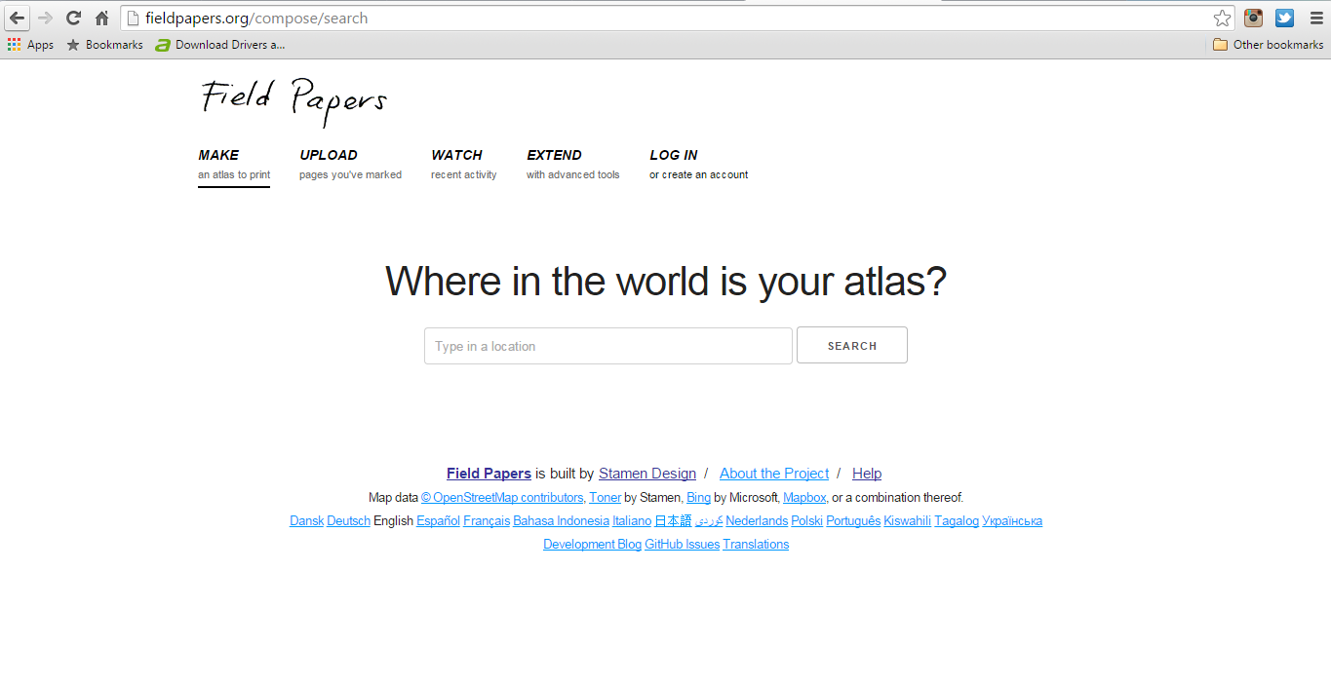
SEARCH FOR AN AREA
NB: You will need to be specific with searching the name of the area. “Dar es Salaam” works fine.

Slide 6
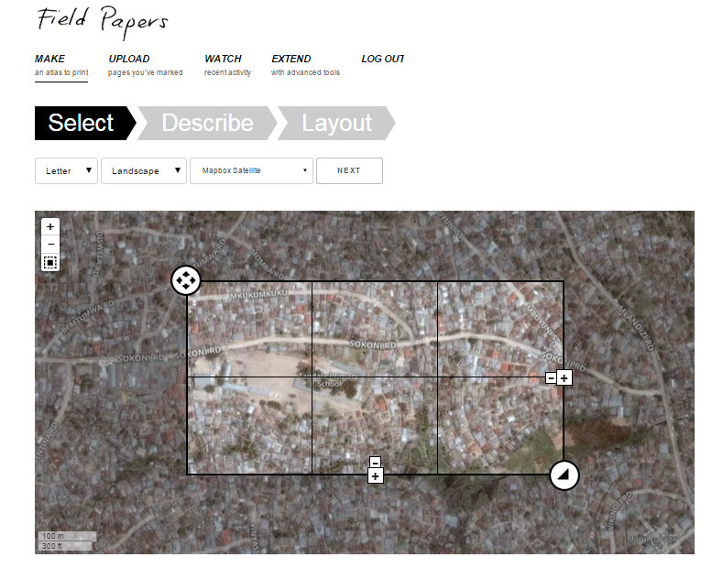
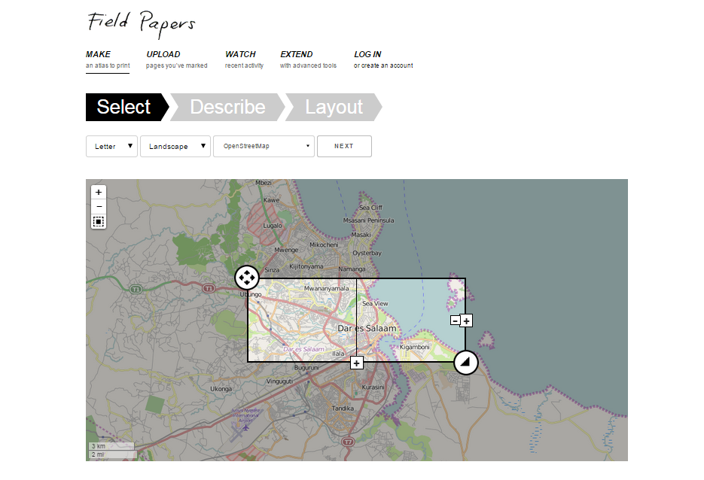
CUSTOMIZE YOUR FIELD PAPER (STEP 1)
Paper size, Orientation, Kind of Map, Zoom Level, Number of portions

Slide 7
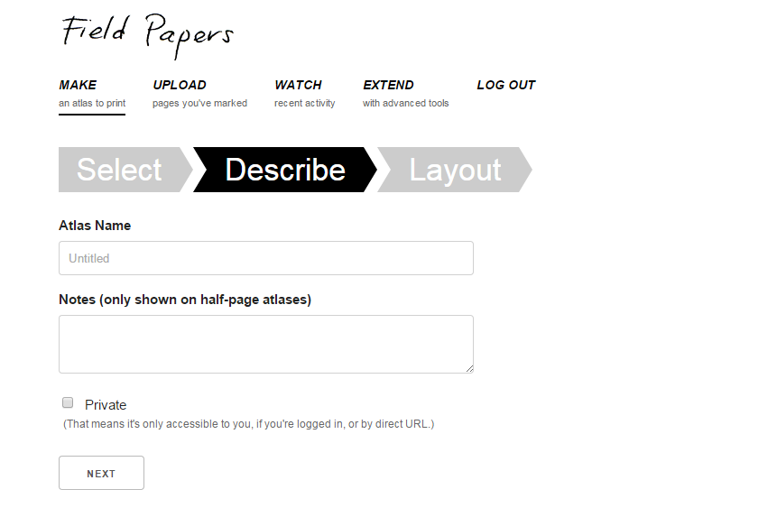
CUSTOMIZE YOUR FIELD PAPER (STEP 2)
Give a name, could be name of the area and a short description of it, could features your interested in.

Slide 8
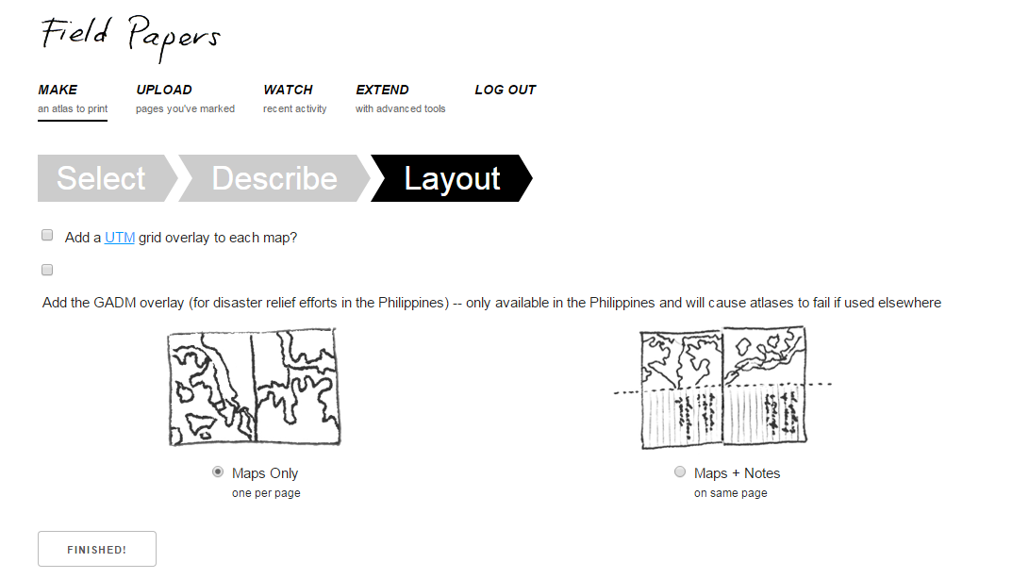
CUSTOMIZE YOUR FIELD PAPER (STEP 3)
Pick an orientation that will work best for you

Slide 9
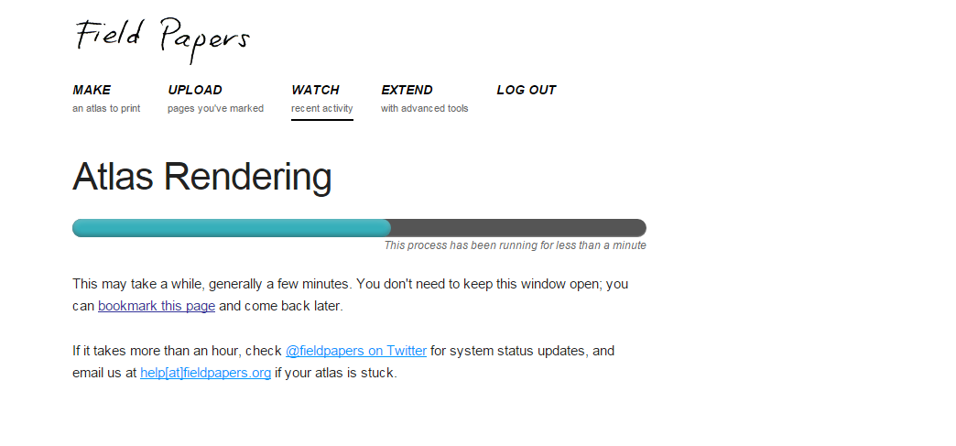
FINISHED!
At this stage your field paper is being Created.

Slide 10
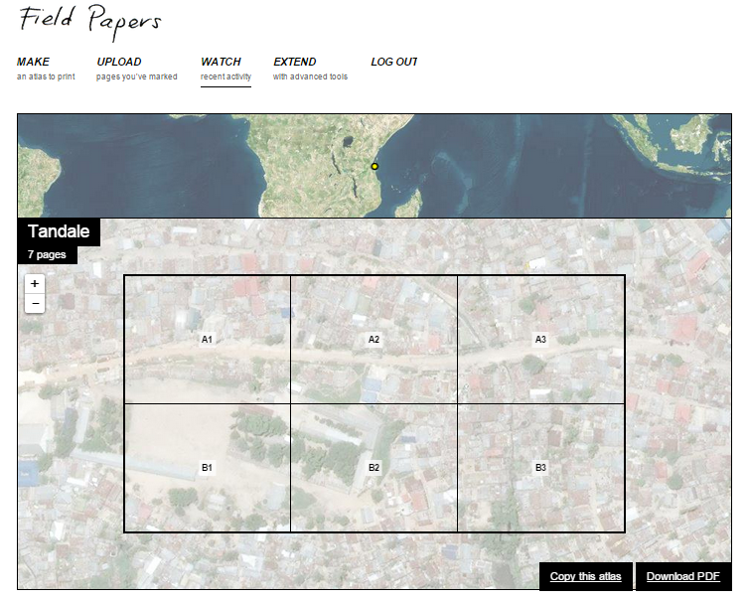
DOWNLOAD
Click the download button on the far bottom right corner to have it saved on your local drive.

Slide 11
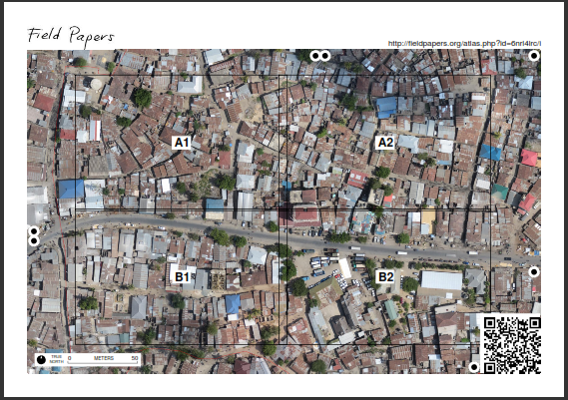
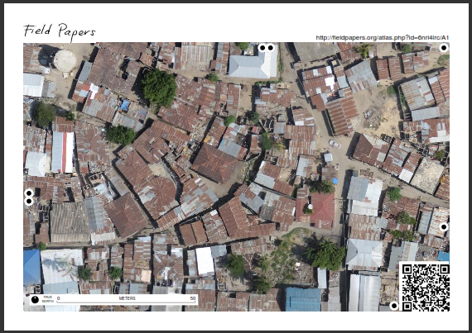
THE PAPERS ARE AUTOMATICALLY PARTITIONED FOR YOU
Its time to collect Data…

Slide 12
HOW IT WORKS….
Print the map
Go out in the field and sketch what you see
Then come back, and either take a photo/make a scan of your map and upload it or just look at your sheet of paper and use it as aid to your brain's memory
Add your surveyed information to the OpenStreetMap database (Will use JOSM in this case)

Slide 13
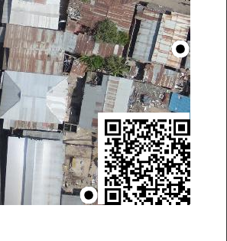
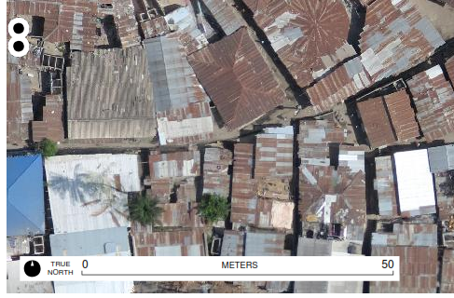
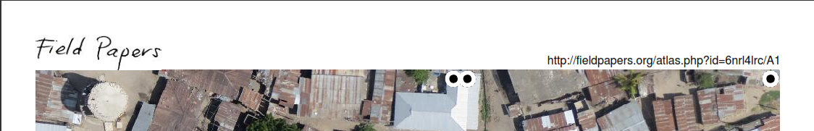
TOOLS TO NOTE!
QR CODE
SCALE
URL

Slide 14
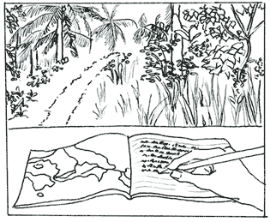
www.fieldpapers.org

Slide 15
GPS Units, OSM Tracker

Slide 16
Introduction to GPS Units and OSM Tracker
How to use a GPS Unit to record waypoints and tracks
Importing GPS data into JOSM
Customizing the GPX layers
Uploading Traces to OSM
OSM Tracker
Loading basemap in GPS

Slide 17
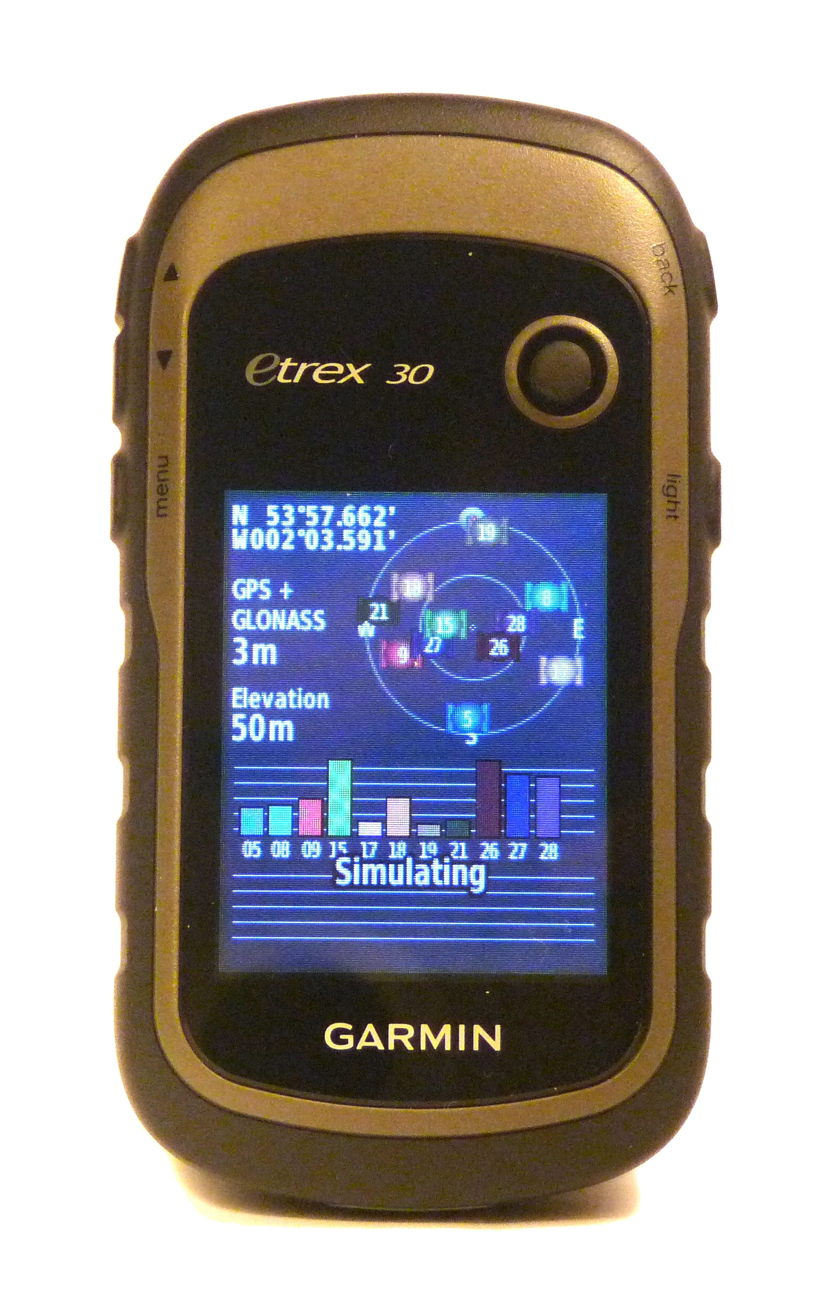
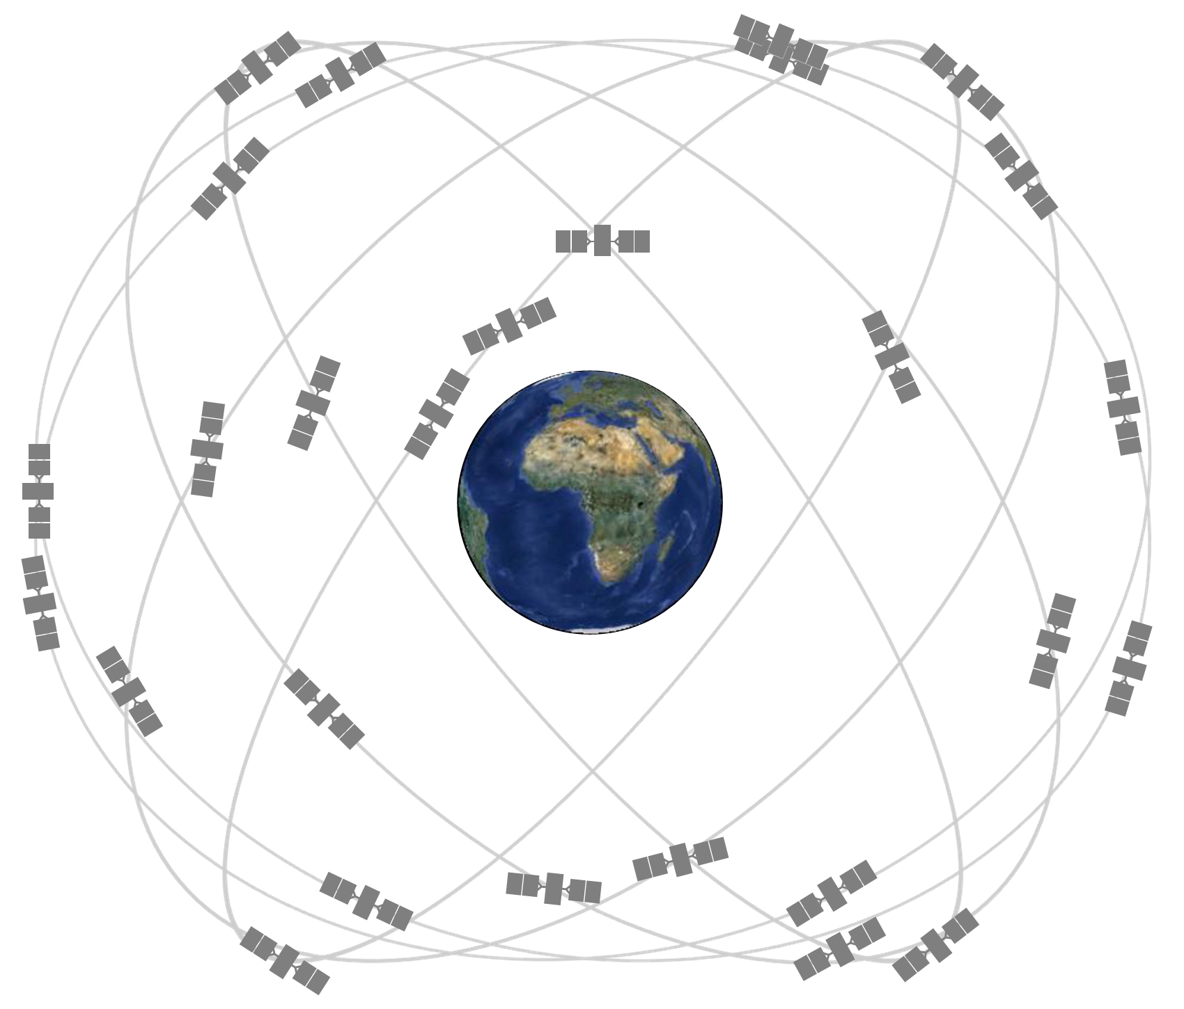
DATA COLLECTION TOOLS
The commonly used Data Collection tools include:
A GPS Unit (Global Positioning System) / Satellite Navigational System
(from gps.gov) Wikipedia Commons, CC by-sa

Slide 18
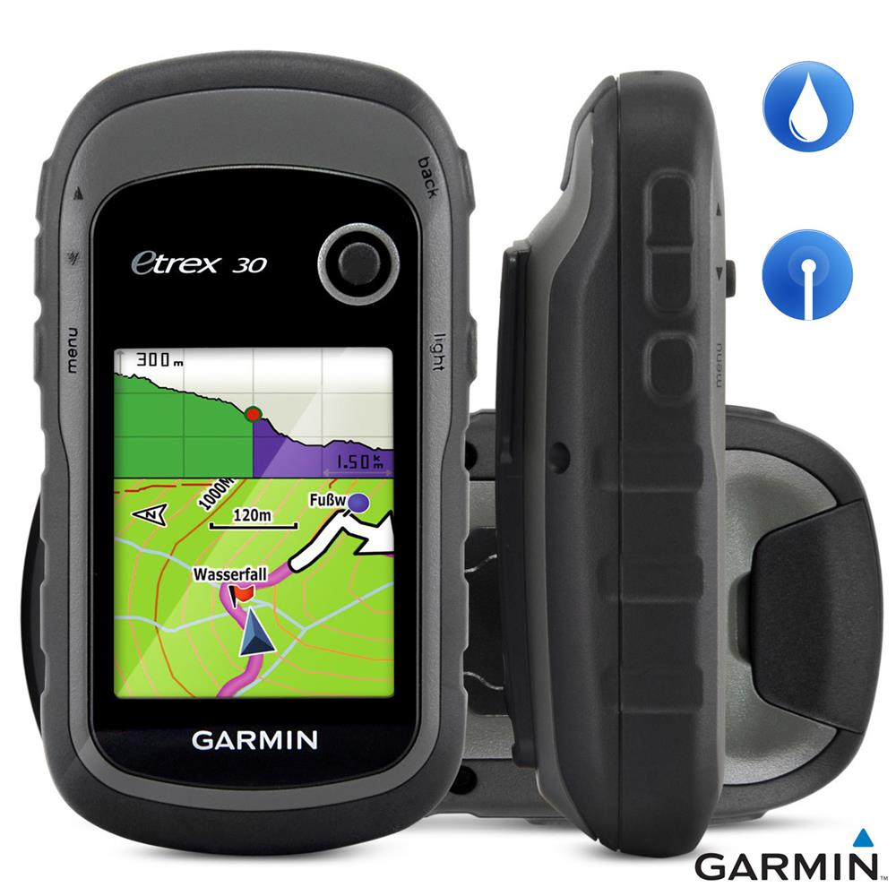
What's a GPS Unit?
A GPS is like a mobile phone, except that instead of receiving radio signals from telephone companies, it receives signals from satellites that are going around the Earth.
promotional picture, © Garmin

Slide 19
How does it work?
By receiving these signals from the satellites, a GPS is able to calculate your exact location on the planet.
It records this location in coordinates, which are two long numbers.
Longitude. (how far East or West you are )
Latitude. (how far North or South you are )
Every place on Earth has unique geographic coordinates

Slide 20
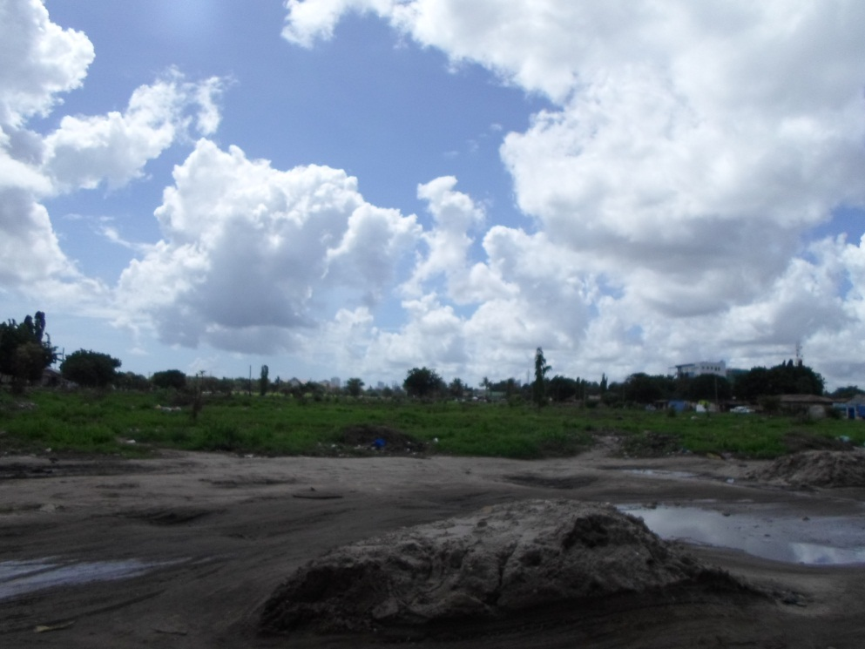
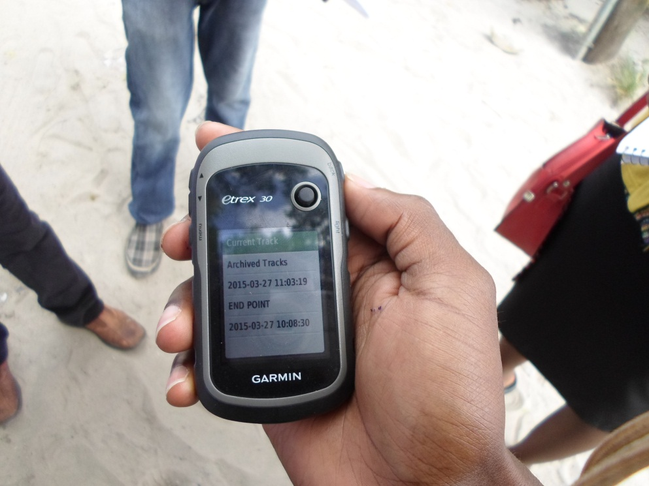
How does it work?
After the device is turned on, it begins acquiring satellite signals.
The devices may need a clear view of the sky to acquire satellite signals.
IT WON’T WORK INDOORS

Slide 21
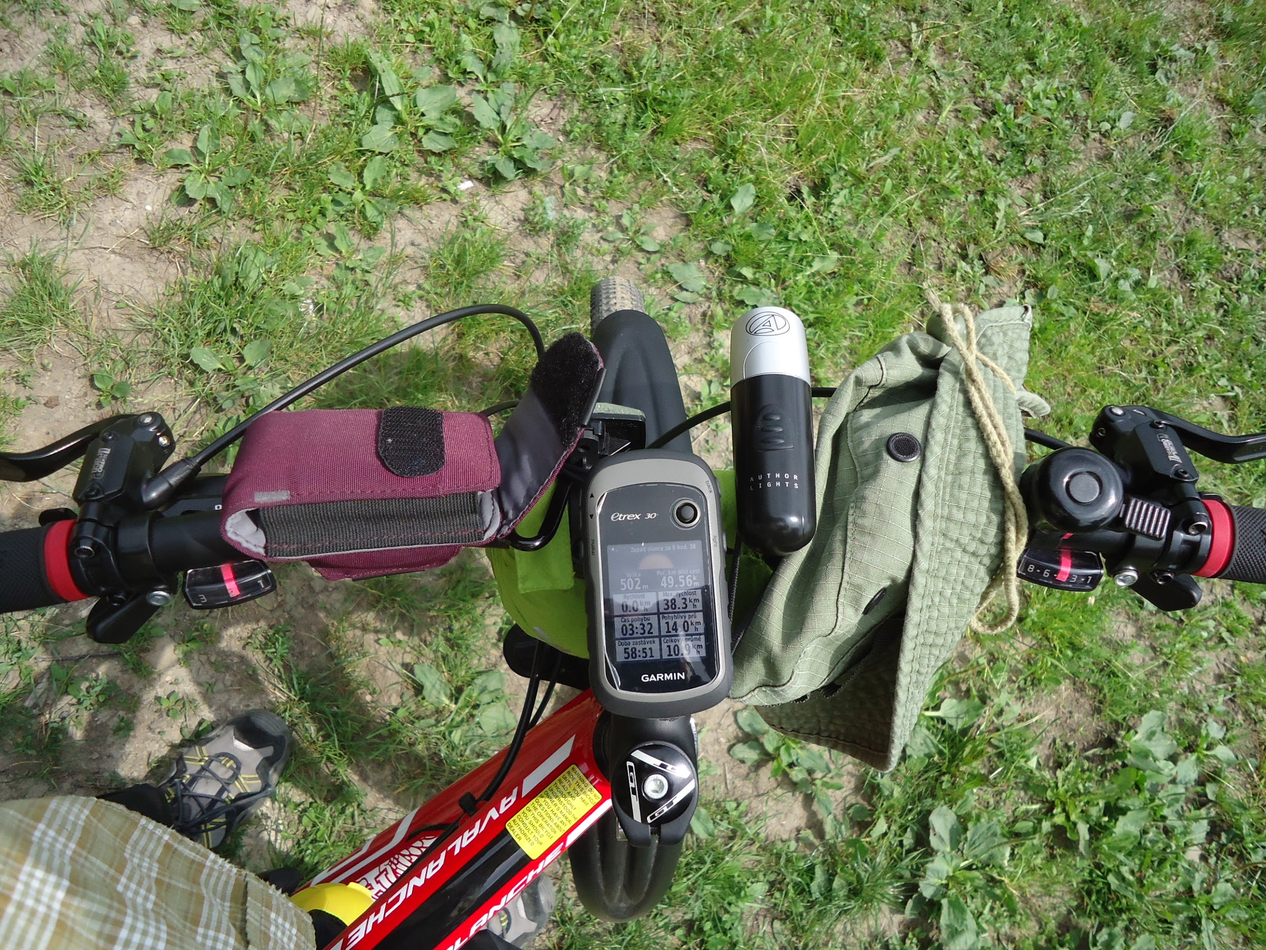
How does it work?
NOTE:
When the GPS bars are solid green, your device has acquired satellite signals. Now your ready to move
The time and date are set automatically based on the GPS position
© Jiri Brizovsky, CC

Slide 22
How does it work?
Your GPS records two kinds of information that are useful for creating maps or saving the coordinates of a place.
First, it allows you to save your location in the memory of the GPS.
When you save a location, the coordinates will be saved with a name.
But they can be changed
For example, your first saved point will be named 001, the second 002, and so on.

Slide 23
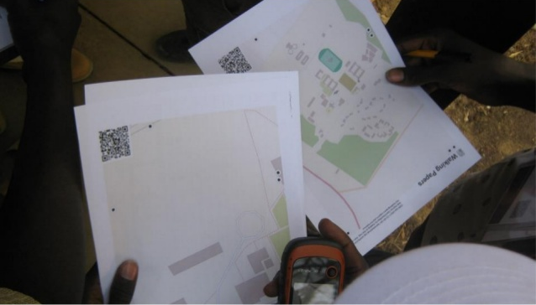
Tracks and waypoints
When you save a point, you can write down the number on a piece of paper, along with a description of what it is.
Plus any attribute or indicators you would like to know.
Saved locations on your GPS are called waypoints.

Slide 24
Tracks and waypoints
Second, your GPS can save what are called TRACKS.
A track will save a series of locations wherever you move hence show the path of where you have been.
Tracks are useful for mapping objects that are represented by lines or shapes, such as the course of a road, or the shape of a field.
Saved Traces on your GPS are called Tracks.

Slide 25
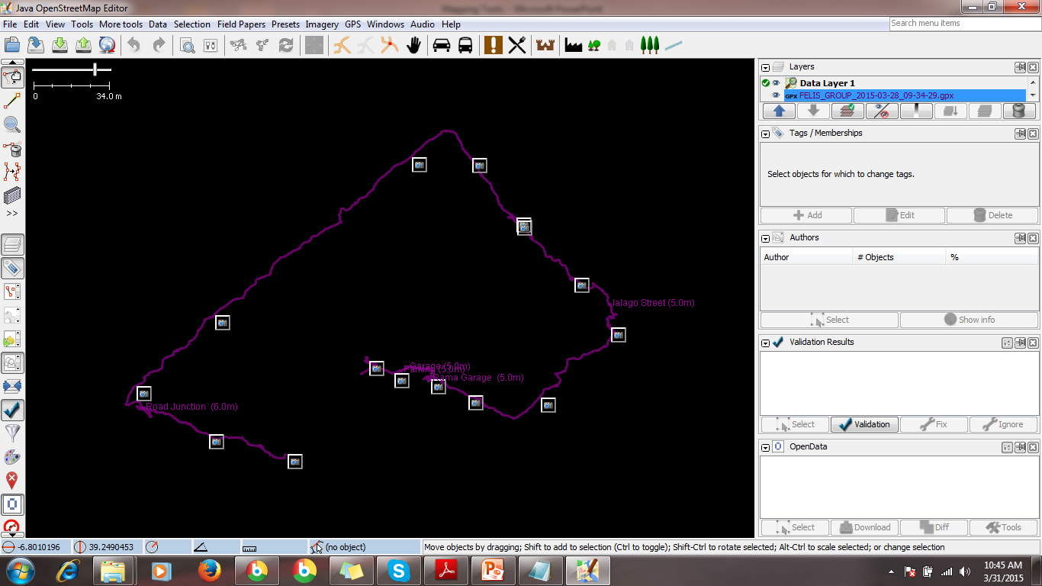

Slide 26
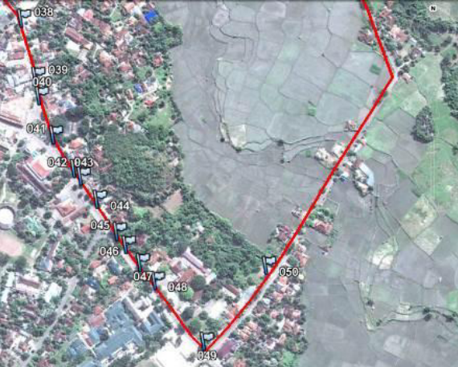
Tracks and waypoints
Be sure to write down the number of the point, along with what the place is and any other information you want to record about the place in your notebook.

Slide 27
Turn on the Track Log
It’s good practice to turn on the log when you begin mapping, and turn it off when you are finished.
When the track log is turned on, it will automatically record your path.
You will then be able to look at the track on a computer and see the path that you mapped.
Mostly features that are in a line manner like roads, rivers etc.

Slide 28
Copy waypoints and track logs to the computer
When you are finished mapping with the GPS you will want to copy the points and tracks to your computer so that you can open them in JOSM.
You may need to install GPS drivers.
One way to copy the waypoints and tracks is to you use the free software that Garmin provides, called “BaseCamp” OR “GPSBabel”
http://www.garmin.com/en-US/shop/downloads/basecamp
http://www.gpsbabel.org/
http://www8.garmin.com/support/download_details.jsp?id=591
In some cases the drivers come pre-installed in the GPS devices (Plug & Play)

Slide 29
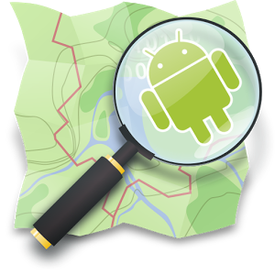
Phone applications

Slide 30
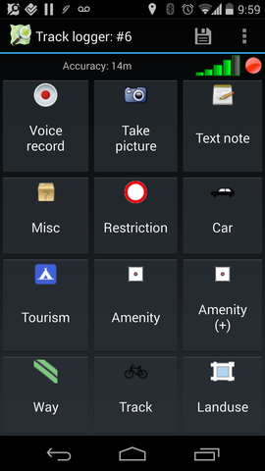
OSM Tracker: requirements for installation
Must be a Smart phone.
(Download from Google Play store or any App Store for phones running on a different OS or can be shared via bluetooth).
Phone must have the GPS feature.
NB: Always turn on the GPS when in use.
For more accuracy, activate data connection.

Slide 31
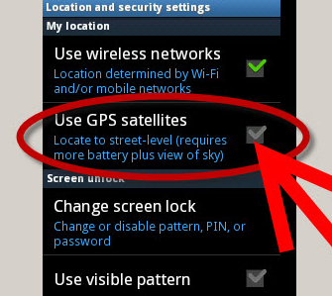

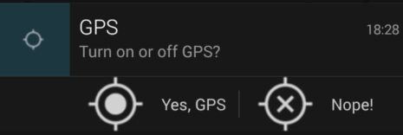
Steps to use OSM Tracker
-Turn on your GPS feature or Location
-Wait for it to connect to the satellite for signals
(NB: The upper menu includes the accuracy level in meters, 5 Meters is good enough 4 a phone)
On the right, there is a signal strength bar, don’t start tracking if its in red color. Green is good/perfect
Go to the menu button and select “new track” or on the plus (+) icon.

Slide 32

Steps to use OSM Tracker
There are awesome ways you can create a waypoint.
You can record your voice.
Take a picture.
Take a note.
-

Slide 33
Steps to use OSM Tracker
OSM has a number of Presets pre-installed
NB: The common features are the ones available aligned in categories.
-
Tap on one menu which will take you to different features that are under its category

Slide 34
Steps to use OSM Tracker
Important things to note
Always stop your track after you are done.
Save your track.
Export your track into GPX file format.
And you can upload your traces directly into OpenStreetMap (You must be having an account).

Slide 35

Other applications
OruxMaps
Vespucci
OSM And

